Slide 2
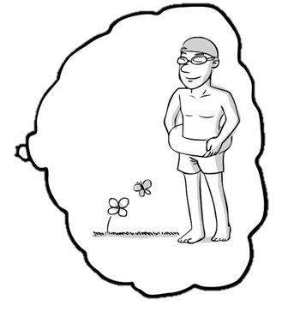
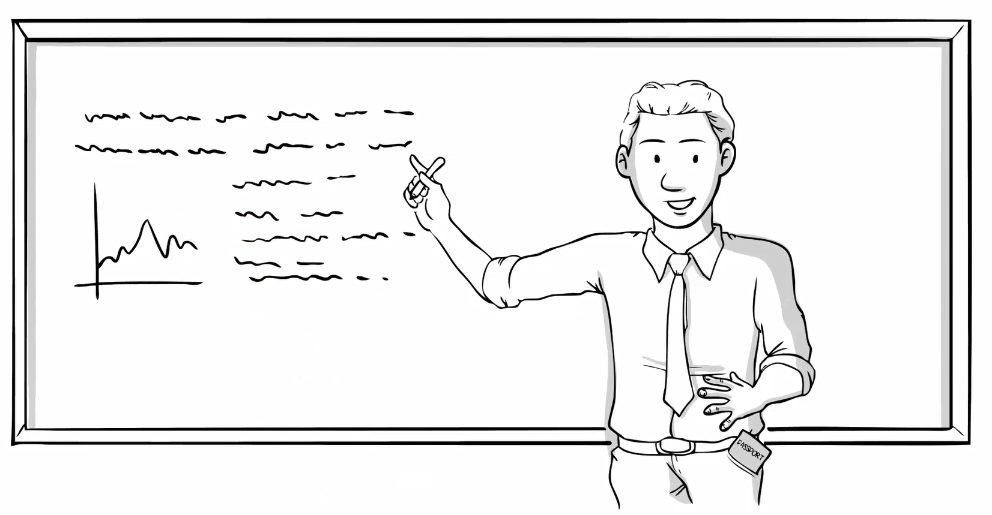
International Business

Slide 4
Every semester:
4,000 students
120 universities
40 countries
6 continents

Slide 5
How it works

Slide 6
Real companies

Slide 7
Challenge
Competition analysis
Most promising new market
Entry mode and distribution
Pricing
Marketing
HR
Logistics

Slide 8
The Ultimate Viability Test
POTENTIAL CLIENTS
IN THE NEW MARKET
Big Retail, Inc.
Huge Sales Co.
Local Distributions
Other Leads Corp.
Contract
$10,000

Slide 9
From: X-Culture Admin, admin@X-Culture.org
To: You
Date: Wednesday
Dear You,
Here is your weekly progress survey link.
Please complete by Sunday.
Admin

Slide 10
Your Grade
X-Culture = 30% of the course grade
30% weekly surveys
3% each
40% peer evaluations
Effort, intellectual contribution, leadership, friendliness, work done
30% report quality
Executive summary, economic viability, formatting, plagiarism
Exercise.
Not a test.

Slide 11
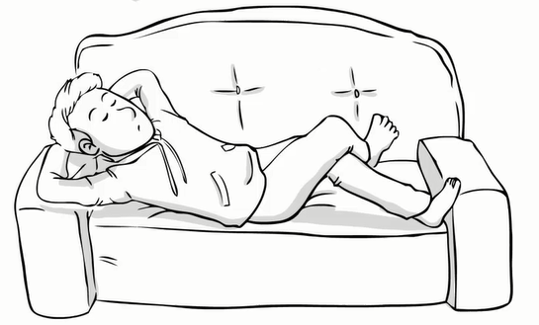
Peer evaluations below 2.0.
Received a warning.
Peer evaluations below 2.0 next week.
Excluded from team.

Slide 12
Submit your file here.
Your similarity report will be ready in a few hours.
If more than 20% of your report has been copied and pasted and not properly referenced, it’s bad.

Slide 13
Real value in experience
Job interview – I have X-Culture

Slide 14
Royal Caribbean

Slide 15
Coaching
COACH

Slide 16
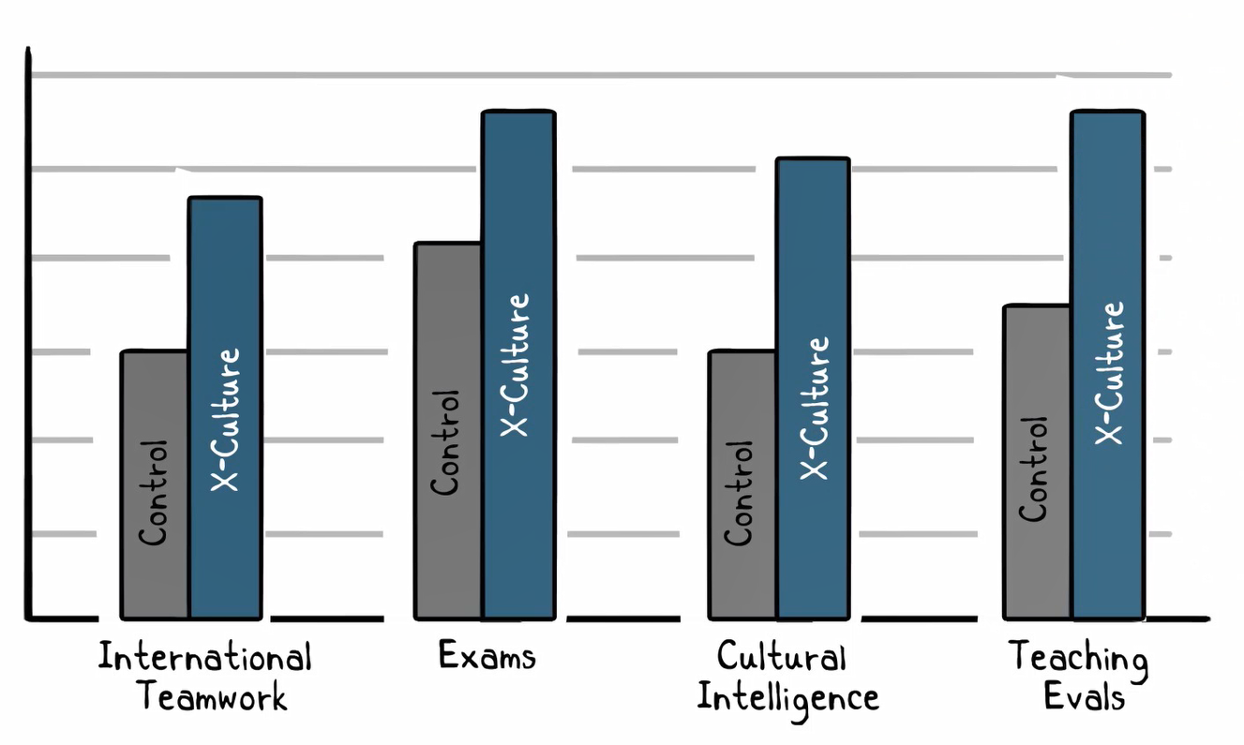
It works!
How it works

Slide 17
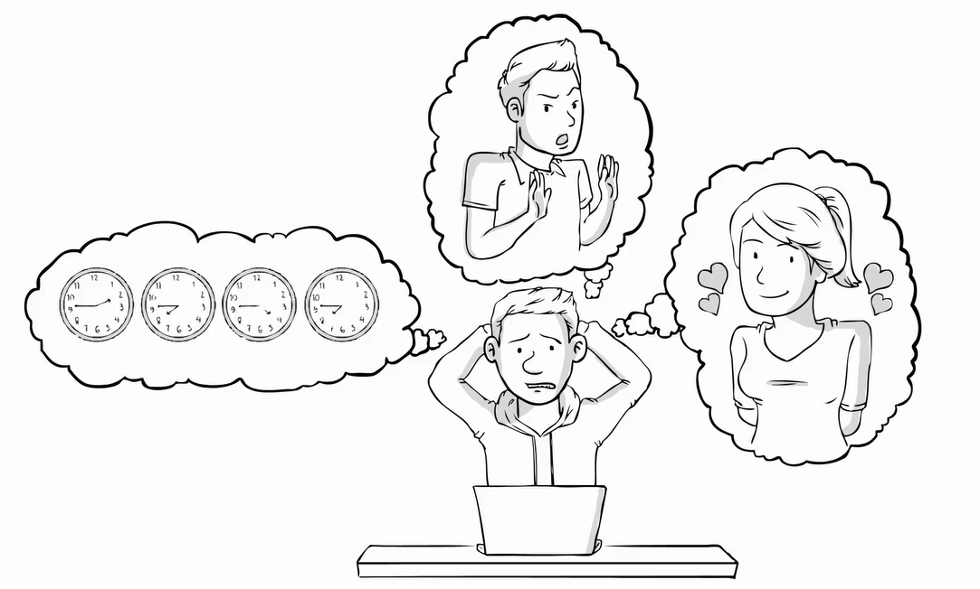
Will be overwhelming at times
Time zones
Email overload
Free-riding
Lack of leadership
Conflicts, bullying, harassment
Plagiarism
Conflicting copies of documents
Calendar differences
Language proficiency

Slide 18
What?!!
Exactly the same problems as in my X-Culture team?!!
It’s not any easier?

Slide 19
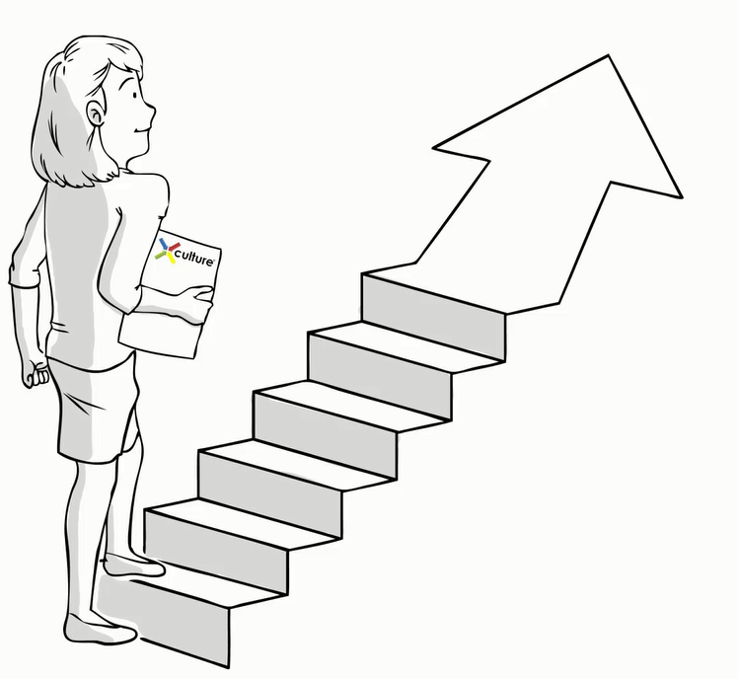
It’ll be OK
and totally worth it!

Slide 20
NEXT STEPS:
Review project materials
Take Readiness Test
Contact team
> Follow the Challenge Instructions

